Slide 1
Relational Model

Slide 2
Basic Structure (1)
Formally, given sets D₁, D₂, …. D_{n} a relation r is a subset of
D₁ x D₂ x … x D_{n}
Thus a relation is a set of n-tuples (a₁, a₂, …, a_{n}) where
each a_{i} ∈ D_{i}
Example: if
customer-name = {Jones, Smith, Curry, Lindsay}
customer-street = {Main, North, Park}
customer-city = {Harrison, Rye, Pittsfield}

Slide 3
Basic Structure (2)
Then r = { (Jones, Main, Harrison),
(Smith, North, Rye),
(Curry, North, Rye),
(Lindsay, Park, Pittsfield)}
is a relation over customer-name x customer-street x customer-city

Slide 4
Basic Structure (3)
Each attribute of a relation has a name
The set of allowed values for each attribute is called the domain of the attribute
Attribute values are (normally) required to be atomic, that is, indivisible
  E.g. multivalued attribute values are not atomic
  E.g. composite attribute values are not atomic

Slide 5
Basic Structure (4)
The special value null is a member of every domain
The null value causes complications in the definition of many operations
  we shall ignore the effect of null values in our main presentation and consider their effect later

Slide 6
Relation Schema
A₁, A₂, …, A_{n} are attributes
R = (A₁, A₂, …, A_{n} ) is a relation schema
E.g. Customer-schema =
(customer-name, customer-street, customer-city)

Slide 7
Relation Instance
The current values (relation instance) of a relation are specified by a table
An element t of r is a tuple, represented by a row in a table

Slide 8
Relation Instance
CUSTOMER table
Customer-id | Customer-name | Customer-street | Customer-city
192-83 | Ahmed | 23 Alma St. | Jbeha
182-74 | Kasim | 12 Main St. | Sweleh
677-600 | Rana | 7 Park Ave. | Marka
321-140 | Susan | 57 North St. | Jabal
710-569 | Tarik | 33 Alma St. | Jbeha
210-872 | Ali | 88 East St. | Gardens
Data-item name
Data-item value
Tuples
(Records)

Slide 9
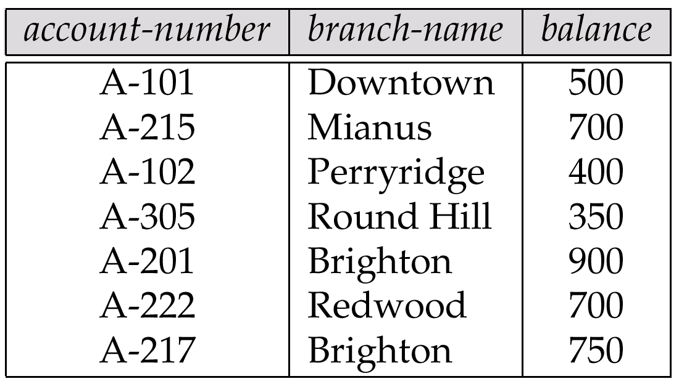
Relations are Unordered
Order of tuples is irrelevant (tuples may be stored in an arbitrary order)
E.g. account relation with unordered tuples

Slide 10
Database
A database consists of multiple relations
Information about an enterprise is broken up into parts, with each relation storing one part of the information. For example:
account :stores information about accounts
depositor : stores information about which customer owns which account
customer : stores information about customers

Slide 11
Database
Storing all information as a single relation such as
bank (account-number, balance, customer-name, ..)
results in
  repetition of information (e.g. two customers own an account)
  the need for null values (e.g. represent a customer without an account)

Slide 12

The customer Relation

Slide 13

The depositor Relation

Slide 14
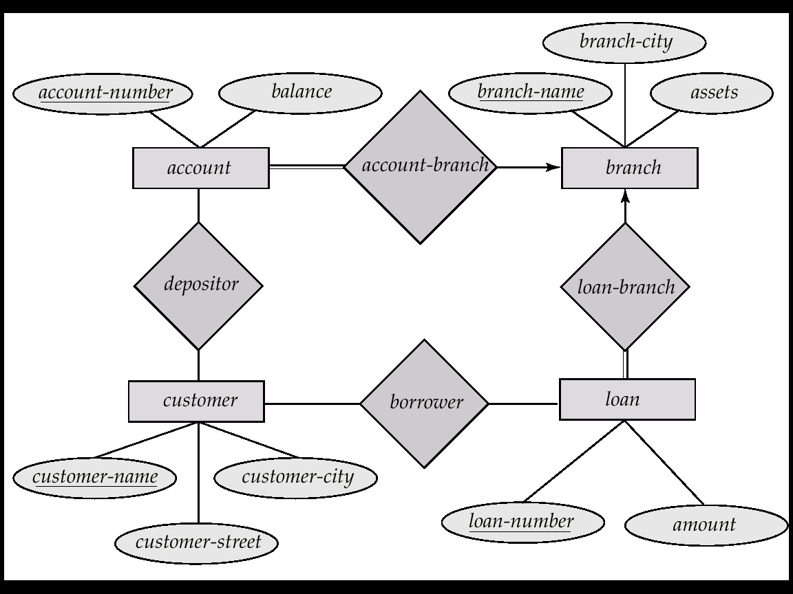
E-R Diagram for the Banking Enterprise

Slide 15

Schema Diagram for the Banking Enterprise

Slide 16
Relational Schema for the Banking Enterprise
branch (branch-name, branch-city, assets)
customer (customer-name, customer-street, customer-only)
account (account-number, branch-name, balance)
loan (loan-number, branch-name, amount)
depositor (customer-name, account-number)
borrower (customer-name, loan-number)

Slide 17
END

